Slide 1
Florida Bright Futures
Scholarship Program
Initial Eligibility

Slide 2
Agenda
Bright Futures:
  Home Screen
  Initial Eligibility Requirements
  Evaluation Process and Award Notifications
Florida Financial Aid Application (FFAA)

Slide 3
Bright Futures Home Screen

Slide 4
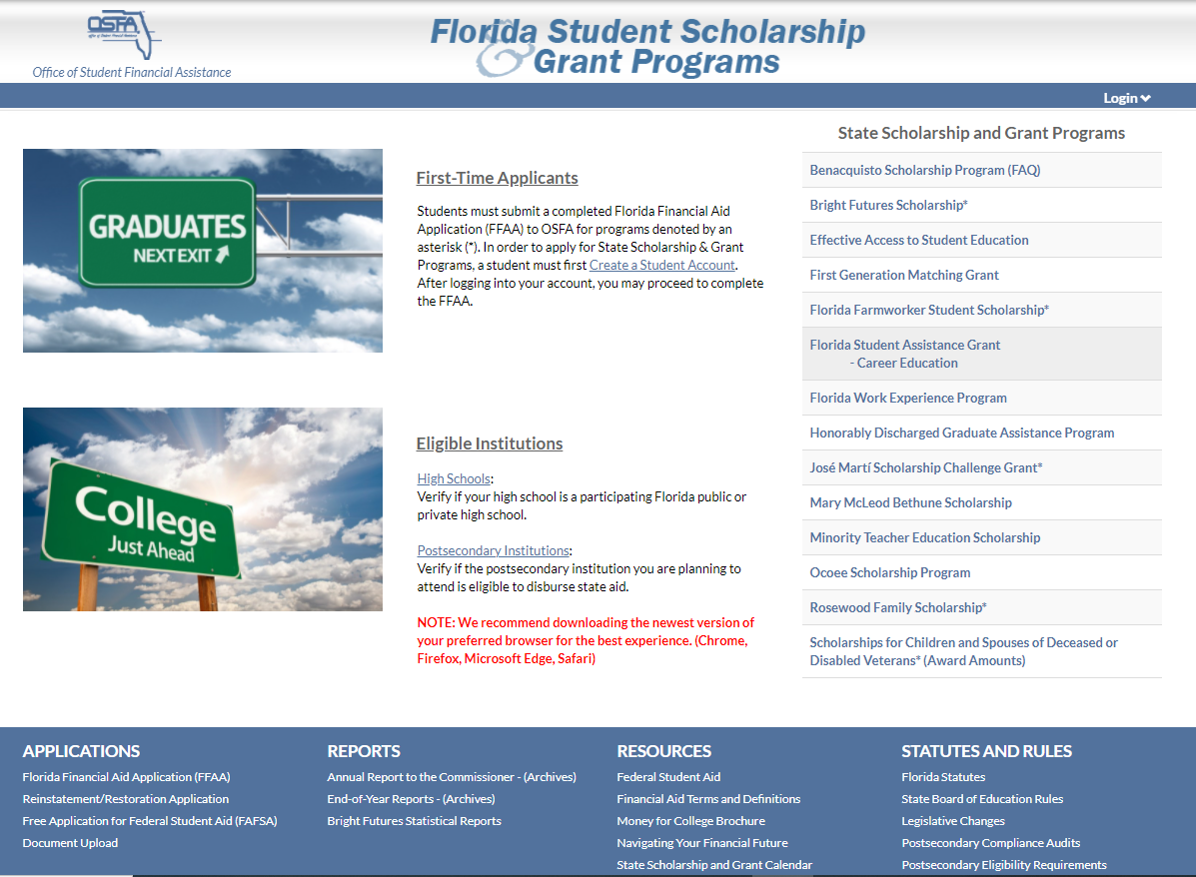
State Scholarship and Grant Programs

Slide 5
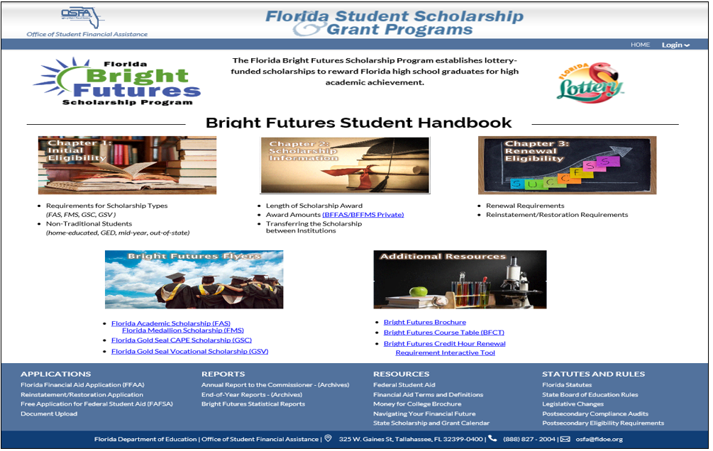
Florida Bright Futures Scholarship Program
Notes:
***PENDING UPDATE***

Slide 6
Bright Futures
Initial Eligibility Requirements

Slide 7
General Requirements
Be a Florida resident and a U. S. citizen or eligible noncitizen, as determined by the student’s postsecondary institution
Complete the Florida Financial Aid Application (FFAA) during senior year of high school beginning October 1, but no later than August 31 after high school graduation
Earn a standard Florida high school diploma, or its equivalent, from a Florida public high school or a registered private high school

Slide 8
General Requirements (Continued)
Not have been found guilty of, or pled nolo contendere to, a felony charge
Be accepted by and enroll as a degree- or certificate-seeking student at an eligible Florida public or independent postsecondary institution within five years of high school graduation
Enroll in at least six non-remedial semester hours (or the equivalent in quarter or clock hours) per term

Slide 9
Bright Futures Scholarship Program Awards
Students may receive funding for ONE of the award levels:
Florida Academic Scholars Award (FAS)
Florida Medallion Scholars Award (FMS)
Florida Gold Seal CAPE Scholars (GSC)
Florida Gold Seal Vocational Scholars (GSV)

Slide 10
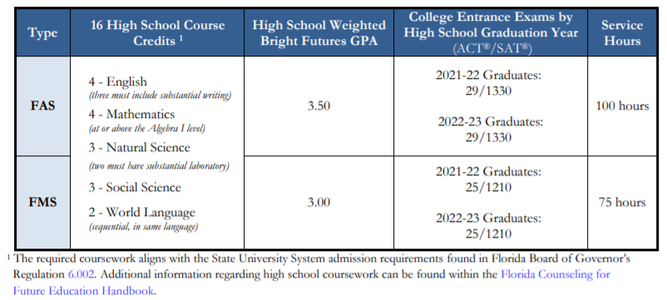
Florida Academic Scholars (FAS) and
Florida Medallion Scholars (FMS)
Award Requirements

Slide 11
Student Report Cards
Section 1009.531 (4), Florida Statutes
Public high school student report cards for 11 and 12 grades must contain a disclosure that the Grade Point Average (GPA) calculated for purposes of the Florida Bright Futures Scholarship Program may differ from the GPA on the report card.
A+

Slide 12
Grade Point Average
Evaluation for Bright Futures includes an unrounded, weighted high school Grade Point Average (GPA) (calculated to two decimal places) in the 16 college-preparatory credits.
The following courses are weighted .25 per semester course or .50 per year course in calculation of the GPA:
Honors
Dual Enrollment
Advanced Placement (AP)
Pre-International Baccalaureate (Pre-IB)
International Baccalaureate (IB)
Pre-Advance International Certificate of Education (Pre-AICE)
Advance International Certificate of Education (AICE)

Slide 13
College Entrance Exams (ACT/SAT)
Students must meet the requirements outlined in statute for either the SAT or ACT.
Per s. 1009.531(6)(c), Florida Statutes, the department shall develop a method for determining the required examination scores which incorporates all of the following:
  FAS scholars – 89th national percentile
  FMS scholars – 75th national percentile
  Scores must be concordant between ACT and SAT
  Publish scores for the rising junior class each year.

Slide 14
College Entrance Exams (ACT/SAT)
Tests taken through June 30 of high school graduation year are accepted for evaluation purposes.
Students will be evaluated based on official test scores from the Florida Department of Education (FDOE) repository. To ensure OSFA obtains official test scores:
Ensure demographics on test registration and high school transcript match; and
Request official single-sitting test scores (not superscore) be sent to one of Florida’s 12 state universities, when registering for the ACT/SAT, even if the student plans to attend an institution which is not a state university.

Slide 15


Service Hours
Each district school board and the administration of a nonpublic school must establish approved activities, the process for documentation of service hours and the established deadline to complete and turn in service hours.
Total service hours completed must be reflected on student transcript submission to OSFA.

Slide 16
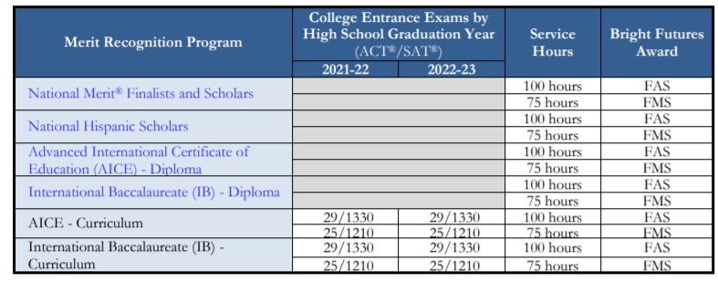
Other Ways to Qualify
Students who have demonstrated academic merit through a recognition program may be eligible for Bright Futures without having to meet one or more of the requirements.
Note: Both AICE and IB Diplomas must be earned prior to high school graduation.

Slide 17
Gold Seal CAPE Scholars (GSC)
Award Requirements
Florida high school students who wish to qualify for the Florida Gold Seal CAPE (GSC) award must meet the following initial eligibility requirements:
Earn a minimum of 5 postsecondary credit hours through CAPE industry certifications which articulate for college credit
Complete 30 service hours

Slide 18
Gold Seal CAPE Scholars (GSC)
GSC may be funded if enrolled in a career education or certificate program.
Upon completion of an associate in science degree program that articulates to a bachelor of science degree, a GSC Scholar may also receive an award for a maximum of 60 credit hours toward a bachelor of science degree program.
Upon completion of an associate in applied science program, a GSC Scholar may also receive an award for a maximum of 60 credit hours toward a bachelor of applied science degree program.

Slide 19
Gold Seal Vocational Scholars (GSV)
Award Requirements
Achieve the required weighted minimum 3.0 GPA in the non-elective high school courses
Take at least 3 full credits in a single Career and Technical Education program
Achieve the required minimum 3.5 unweighted GPA in the career education courses
Achieve the required minimum score on the ACT®, SAT® or Florida Postsecondary Education Readiness Test (P.E.R.T.) exams
Complete 30 service hours

Slide 20
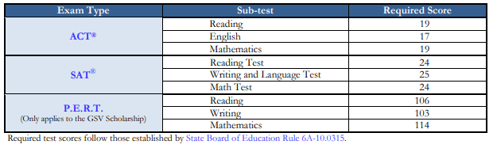
Gold Seal Vocational Scholars (GSV)
Award Requirements (Continued)
Required minimum score table:

Slide 21
Gold Seal Vocational Scholars (GSV)
GSV Scholars awards may only be used at postsecondary institutions that offer:
Applied Technology Diploma
Technical Degree Education Program (associate in applied science or associate in science)
Career Education Certificate Program

Slide 22
Bright Futures Evaluation Process and
Award Notification

Slide 23
Evaluation Periods
There are two evaluation periods:
  Early Evaluation
  Final Evaluation
Transcripts should be submitted within 30 days of the end of each semester

Slide 24
Early Evaluation
Students cannot lose an award based on early evaluation unless they fail to earn a standard Florida high school diploma from a Florida public or
FDOE-registered private high school.
Early Evaluation is based on:
Required coursework and GPA through 7th semester
Coursework in progress for 8th semester
Service hours earned through January 31
Test scores for tests taken through January 31

Slide 25
Final Evaluation
Final Evaluation is based on:
All required coursework and GPA completed by high school graduation
Service hours completed by a date established by the public school district/nonpublic school administrators
Test scores for all tests taken through June 30 of high school graduation year
High school graduation date associated with earning a standard high school diploma

Slide 26
Eligibility Notifications
Upon creation of a Student Account, students will receive a User Name and Password.
Students must check their online account for award notices – students are responsible for keeping their demographic information updated and tracking their application and award status.
OSFA will post official award eligibility or ineligibility determinations to student online accounts.
Students awarded IB or AICE Diplomas will receive notifications of eligibility determination in early fall after a list of AICE and IB Diploma recipients has been received. These students must have filled out a FFAA prior to August 31 to receive the award.

Slide 27
Award Amounts
FAS scholars attending a public institution will receive an award to cover 100% of tuition and specific fees.
FMS scholars attending a public institution will receive an award to cover 75% of tuition and specific fees.
  (New) Beginning with the fall 2021 term, FMS students attending a Florida College System institution (28 State/Community Colleges) who enroll in an associate degree program will receive an award to cover 100% of tuition and specific fees.

Slide 28
Award Amounts (Continued)
FAS and FMS students attending a nonpublic institution will receive a comparable amount as noted in the Private Award Chart accessible through the Bright Futures Student Handbook, Chapter 2, page 4 https://www.FloridaStudentFinancialAidsg.org/PDF/BFHandbookChapter2.pdf
For the GSC and GSV awards, students will receive the specified award amounts established annually by the Florida Legislature in the General Appropriations Act.
For current year award amounts, visit https://www.FloridaStudentFinancialAidsg.org/SAPBFMAIN/SAPBFMAIN

Slide 29
Florida Financial Aid Application (FFAA)

Slide 30
Application Dates
The Florida Financial Aid Application (FFAA) for current high school seniors seeking funding for the 2022-23 academic year is open from October 1, 2021 through August 31, 2022
For Bright Futures eligibility consideration, students must complete the FFAA no later than August 31 after graduation
Students must complete the FFAA no later than April 1 before graduation for:
  José Martí Scholarship Challenge Grant (JM)
  Rosewood Family Scholarship (RFS)
  Scholarships for Children and Spouses of Deceased of Disabled Veterans (CSDDV)*
  Florida Farmworker Student Scholarship (FFSS)
  Randolph Bracy Ocoee Scholarship Program (OCOE)
*CSDDV applications will be accepted after April 1; however, may not receive priority funding due to being a late applicant

Slide 31
Application Two-Step Process
Completing the FFAA is a two-step process:
Create a Student Account
Complete the FFAA

Slide 32

Step 1. Create Student Account

Slide 33
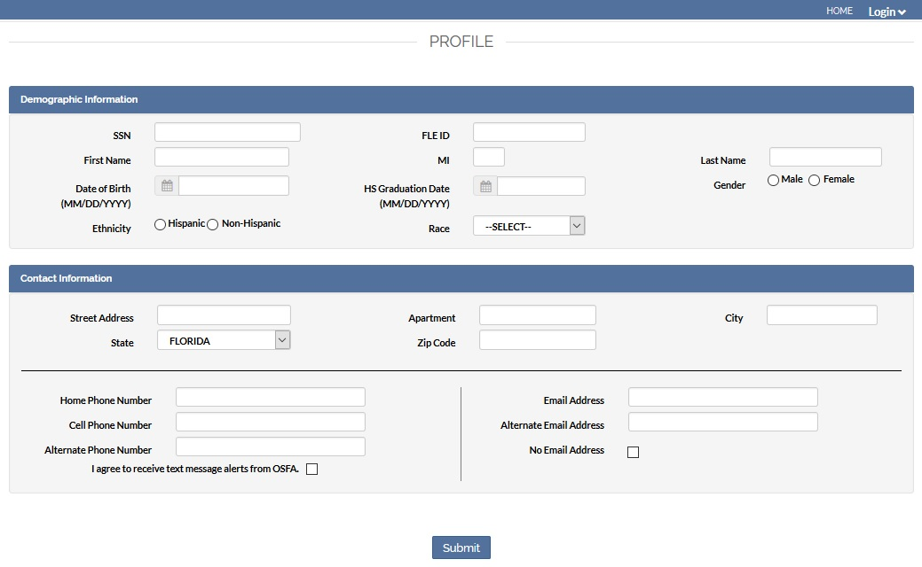
Create Student Account (Continued)

Slide 34
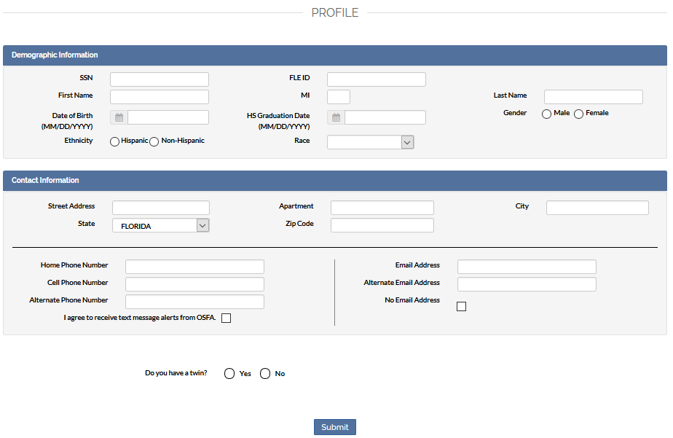
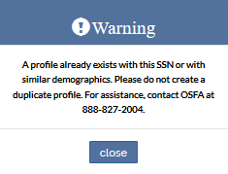
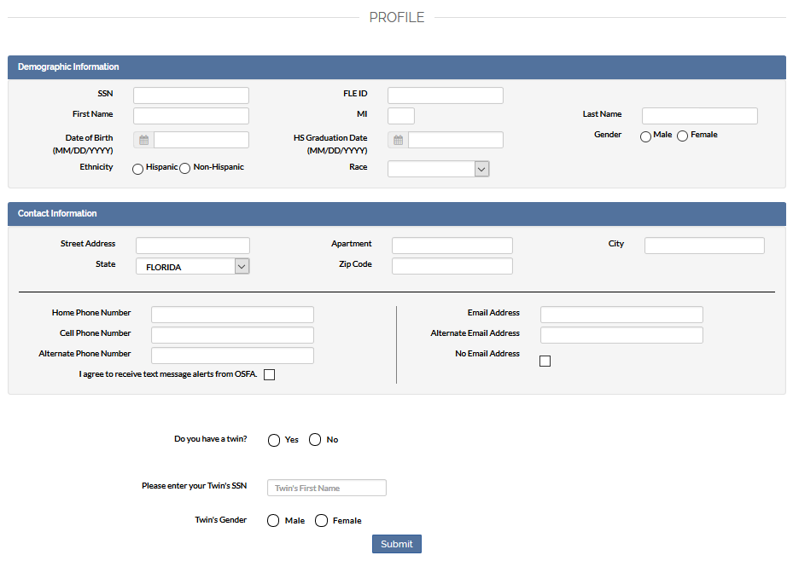

Twin Profiles

Slide 35
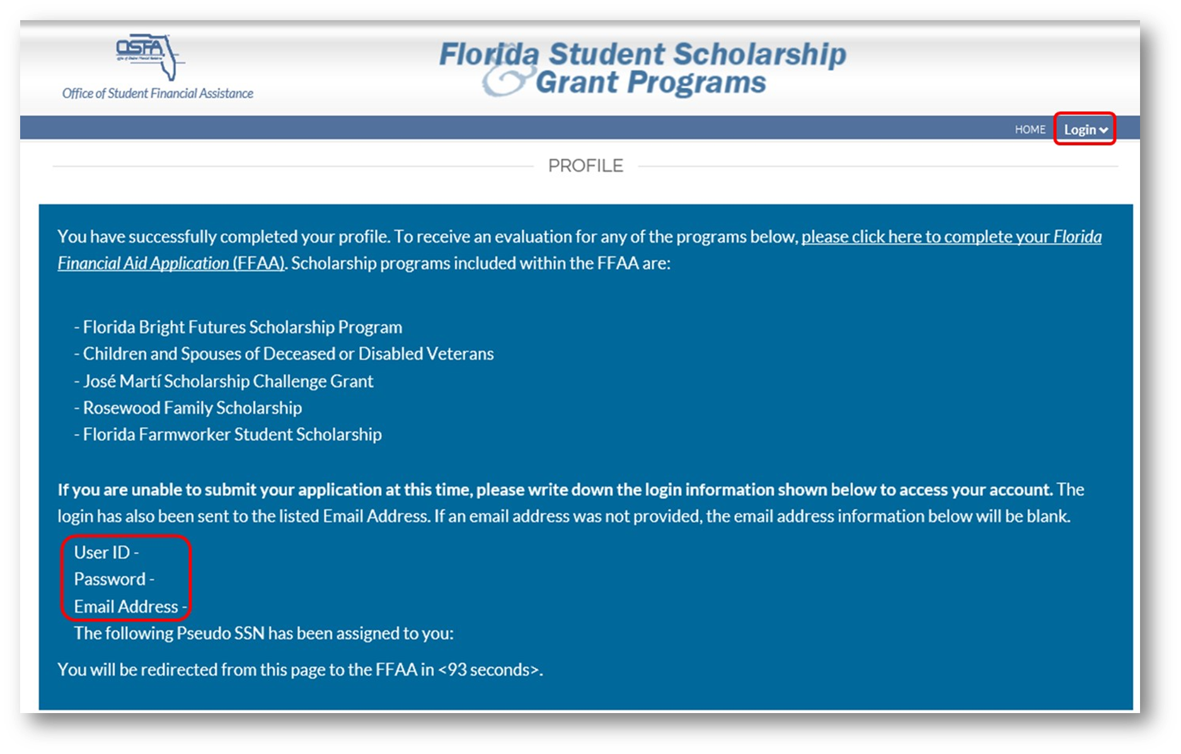
Login Credentials

Slide 36
Step 2. Complete and Submit
Florida Financial Aid Application (FFAA)

Slide 37
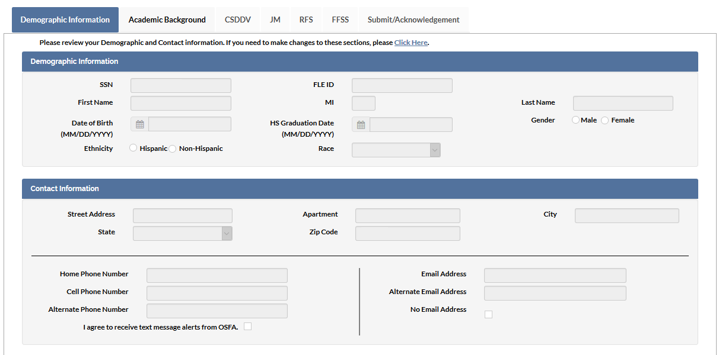
Demographic Information

Slide 38
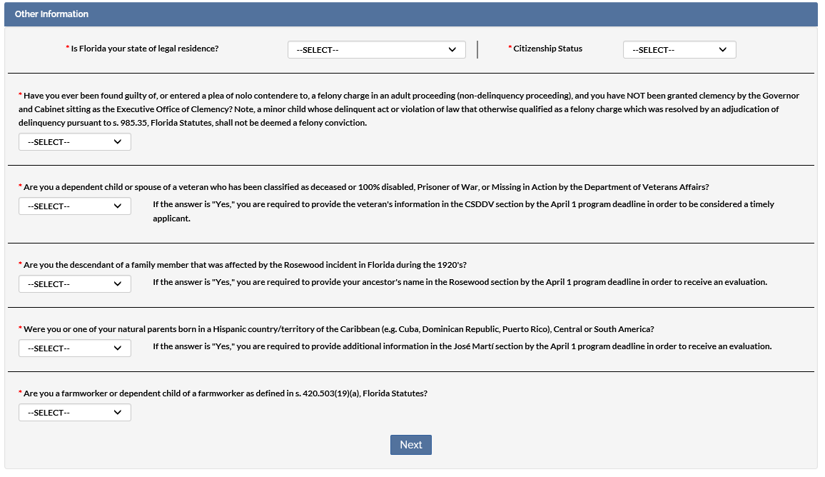
Demographic Information (Continued)

Slide 39
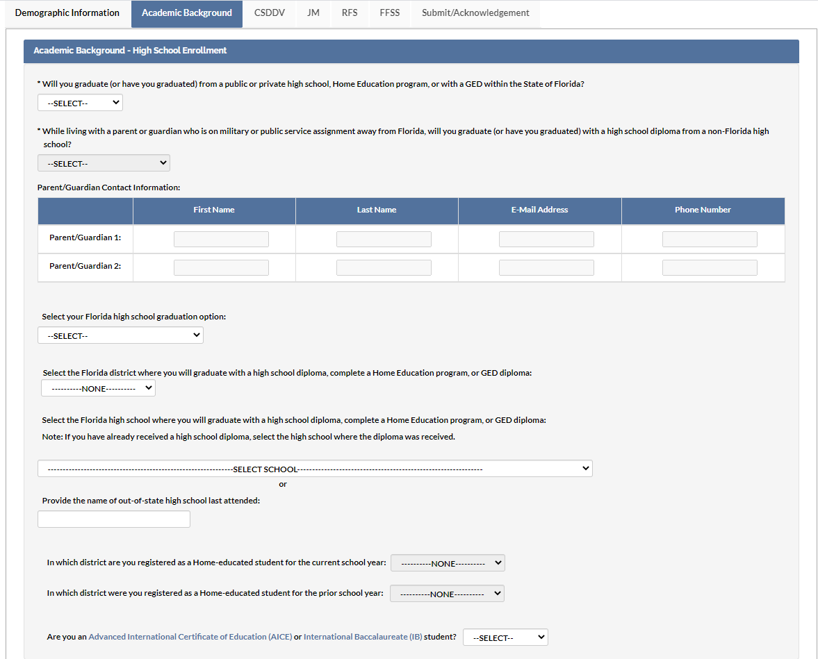
Academic Background

Slide 40
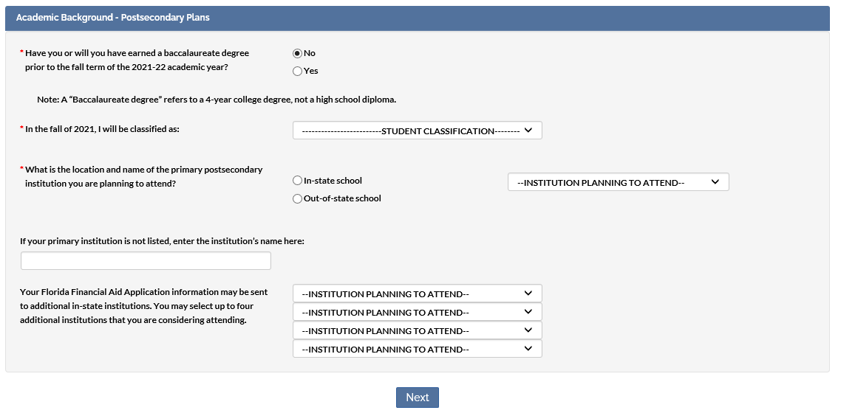
Academic Background

Slide 41
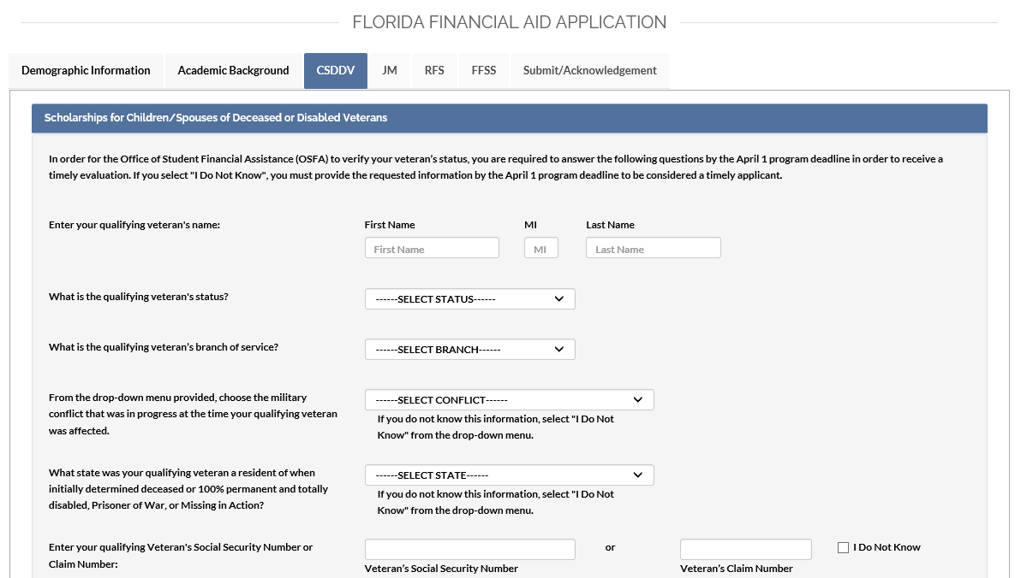
Scholarships for Children and Spouses of Deceased or Disabled Veterans (CSDDV)
Questions requiring a response

Slide 42
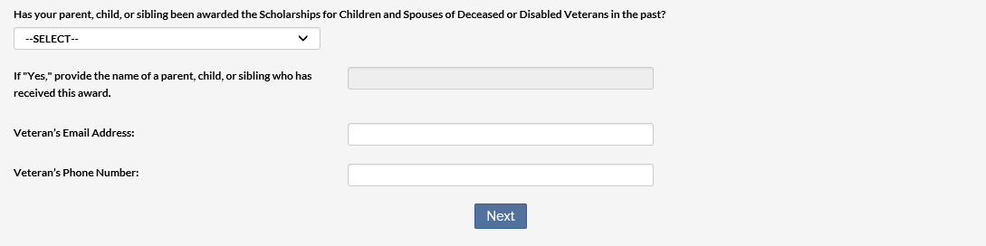
Scholarships for Children and Spouses of Deceased or Disabled Veterans (CSDDV)
Notes:
The final three questions are optional; however, data provided here allows the 3rd party certifier to expedite the certification process.

Slide 43
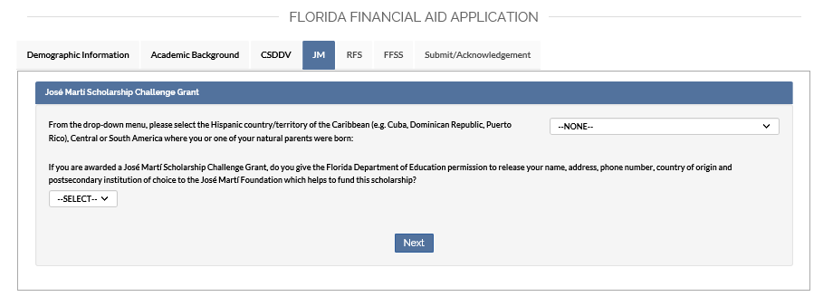
José Martí Scholarship Challenge Grant

Slide 44
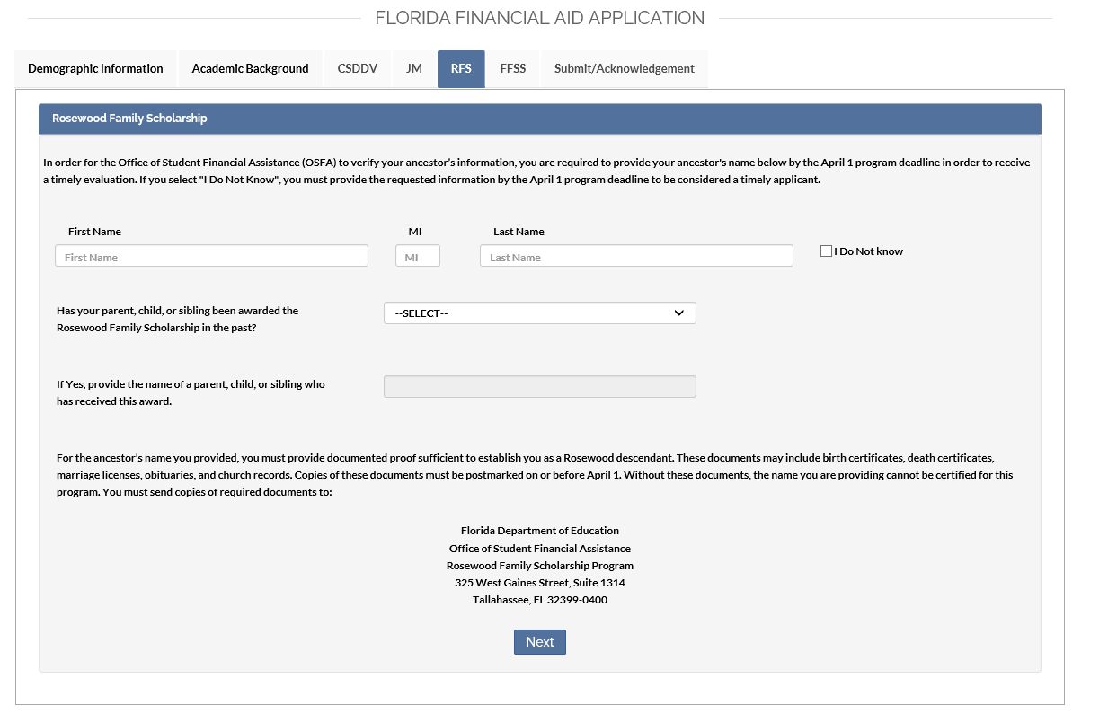
Rosewood Family Scholarship

Slide 45
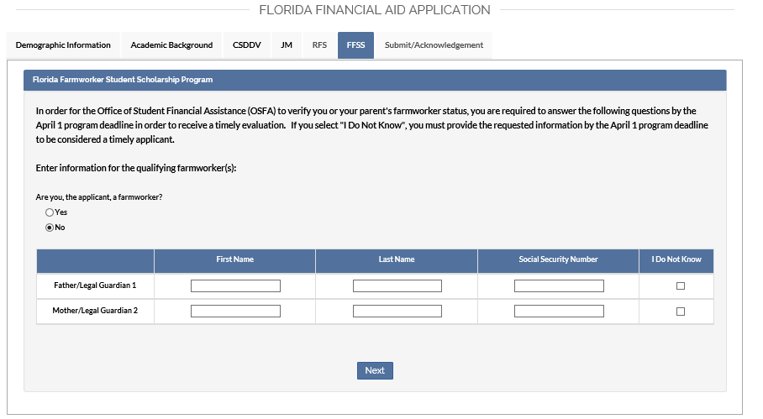
Florida Farmworker Student Scholarship

Slide 46
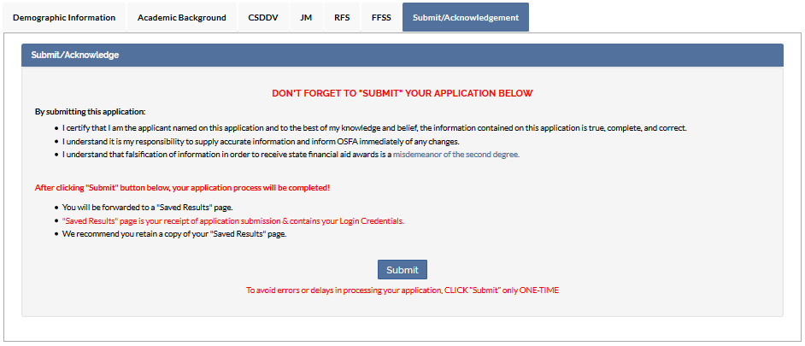
Submit/Acknowledgement

Slide 47
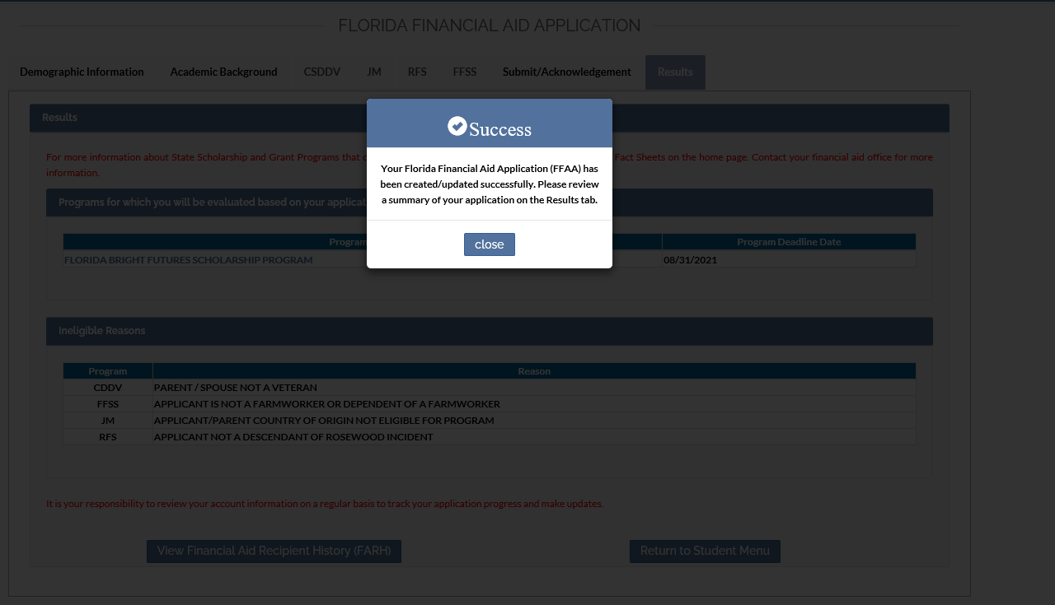
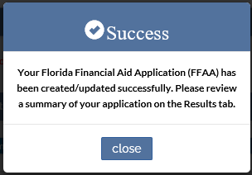
Successful Submission

Slide 48
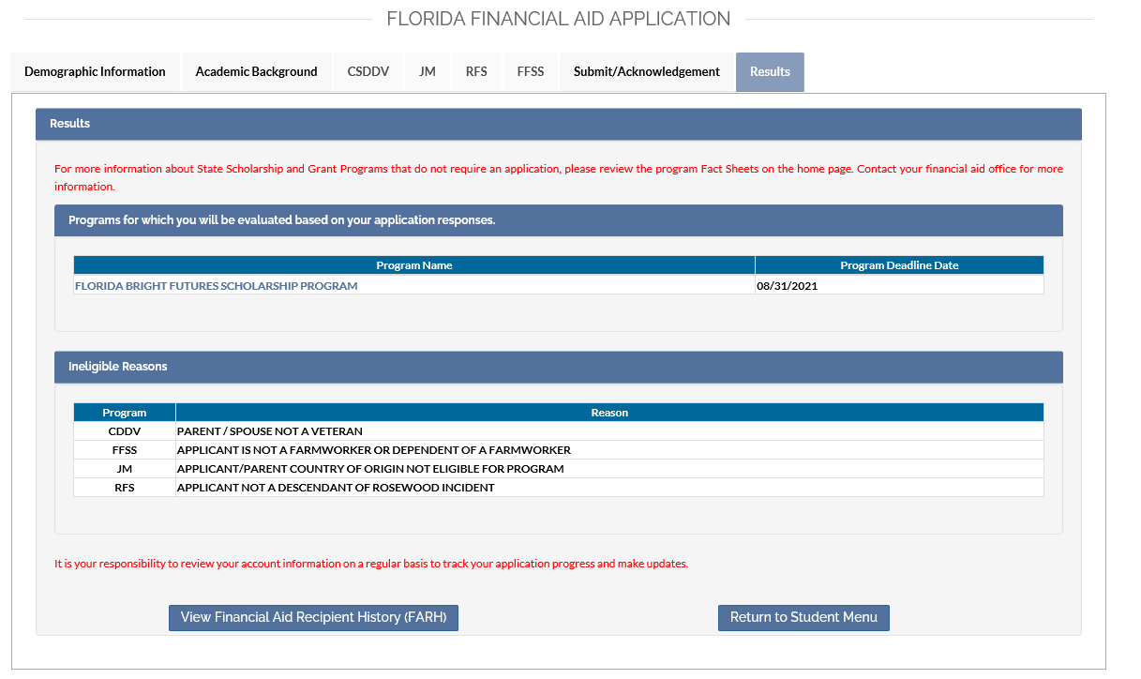
Results

Slide 49
For More Information
Visit www.FloridaStudentFinancialAidsg.org
Contact Customer Service at 888-827-2004
Email OSFA@fldoe.org
www.FloridaStudentFinancailAid.org/FASTER/
FSTR@fldoe.org
Pedro Hernandez
Outreach Director
850-245-1821
Pedro.Hernandez@fldoe.org

