Slide 1
River Ridge High School Senior Parent Night
What Seniors and Their Parents Need To Know About Post Secondary Planning

Slide 2
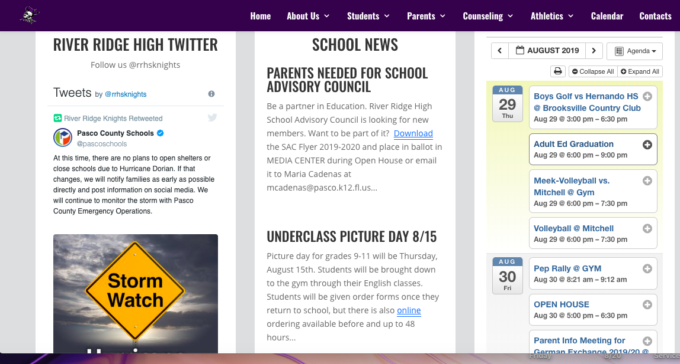
Senior Year is all about staying connected !

Slide 3
Mrs. Peterson has a webpage?

Slide 4
Which Pathway Is Right For Me?
HIGH SCHOOL GRADUATION
WORKPLACE
MILITARY
BA OR BS DEGREE
TECHNICAL TRAINING
AS OR AA DEGREE

Slide 5
What if I don’t know what I want to do?
Explore!
www. Floridashines.org
Interest Inventories and Values Assessments
Identify Career Pathways
Education you need for these careers
College Majors for these pathways
Colleges that offer these majors

Slide 6
Going straight to work? Some things to consider:
Resume
Proficiency Testing
Your references
Interviewing practice
On the job training
Background checks?
Drug tests?
Do your research!

Slide 7
Technical Training
Many of the fastest growing occupations in Florida require a postsecondary vocational certificate or associate degree (A.S.). Examples of these careers include the following:
Medical Assistants
Web Developers
Electricians
Sonographers
Industrial Machinery Mechanics
Brick/Block Masons
Software Developers
WATCH FOR TECHNICAL TRAINING CAREER EVENTS AT RRHS IN MARCH 2020
Source: Florida Department of Economic Opportunity, www.floridajobs.org

Slide 8
Where to Get Technical Training
Marchman Technical College
Pasco Hernando State College
Hillsborough Community College
St Petersburg College
Rasmussen College
And more. . . . . .
http://www.rwm.org/florida-trade-schools/

Slide 9
Associate of Arts Degree
State Colleges
Designed for transfer to a four year college or university
2+2 plan
SUS admissions criteria change when you transfer with an AA!
More affordable
Always plan with the end in mind!
Don’t apply until second semester.

Slide 10
Bachelor’s Degree BA and/or BS
Competitive admissions in SUS
There is more than one way to get to your top pick university!
Refer to SUS Admissions Matrix for requirements, deadlines etc.
Applications differ from school to school (Institutional, Common, Coalition)
Average $17,000-20,000 per year for tuition, room and board
Private schools and out of state schools will be more-amount varies.
Choose a school for the right reasons!

Slide 11
Military
Great option for many students
Each branch has their own qualifications
Must take the ASVAB: Next test here on October 31st, 7:30 AM in Media Center.
Be SURE you understand what your score means for jobs available to you!
Can take college classes during time serving
For more information meet with a recruiter

Slide 12
Financial Matters
Financial Aid Night Workshop: Oct. 16th RRHS 6:30 PM in Media Center
4 Ways to Fund College Expenses
It all starts with the FAFSA! Application opens October 1st.
Scholarships
Bright Futures
Merit Institutional based on GPA, tests, athletics, leadership, service etc.
Local that I advertise
Scholarship Search Engines
Privately funded through school you will be attending
Grants
Loans
Private savings plans and out of pocket

Slide 13
Application opens 10/1/2019
Don’t need to wait to meet qualifications!
Top Tier (FAS) 100% full tuition and fees and $300 for books each semester
FMS 75% of tuition and fees, no book stipend
GSV and Gold Seal Cape-$39-$48 per credit hour in vocational program of study
Go to www.floridastudentfinancialaid.org for more detailed information
FFAA and FAFSA-What is the difference?

Slide 14
Community Service
What kinds of hours qualify? See brochure for details.
Why do community service if I won’t qualify for Bright Futures? Is it a graduation requirement?
How do I find out about where I can do my hours?
Check my webpage for information, ask friends, neighbors, look for organizations in your community who might need help.
To whom do I turn in my Proposal form and logged hours? Mrs. Touchton-Sawyer in Guidance /Mrs. Peterson (backup)
Turn them in quarterly!
DO NOT WAIT UNTIL THE 11th hour to check your hours!

Slide 15
September/October Priorities
Explore options for careers, majors, training needed if not sure already
Applications! Give yourself enough time to submit quality applications.
College Night @ PHSC-West Campus: September 10th, 6-7:30 pm
Take SAT/ACT tests soon for admissions evaluation.
Complete the FAFSA Opens October 1, 2019-Financial Aid Workshop 10/16
Register/Apply for Bright Futures October 1, 2019
Begin scholarship search and applications
Work hard in all your classes-senior year grades are very important!
Make sure you have all graduation requirements including passing state tests!

Slide 16
Resources
www.fldoe.org Florida Department of Education
www.floridastudents.org Educational Resources
www.floridastudentfinancialaid.org Bright Futures
https://fafsa.ed.gov/ FAFSA
www.collegeboard.org SAT Testing
www.act.org ACT Testing
www.floridastudentsachieve.org All grade level info for parents
www.floridashines.org Career and College Exploration
www.findmycollegemajor.org Career and Major Exploration
http://www.bls.gov Job outlooks, Florida statistics by occupation
www.FloridaNEXT.com College Planning and Scholarships Magazine
www.fastweb.com Scholarship search (only one option of many)

